Slide 1

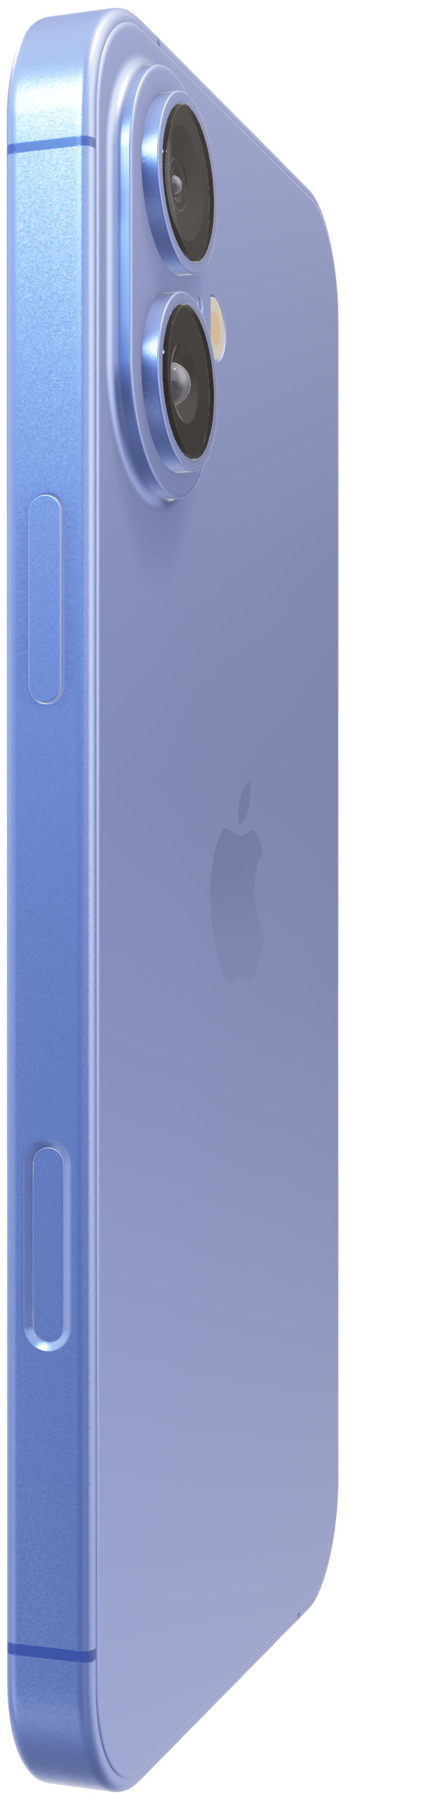
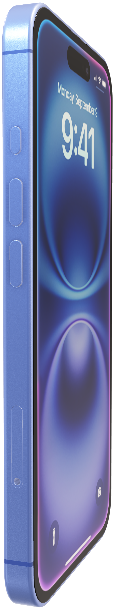
Analog Computer
EN2091 - Laboratory Practice and Projects.

Slide 2


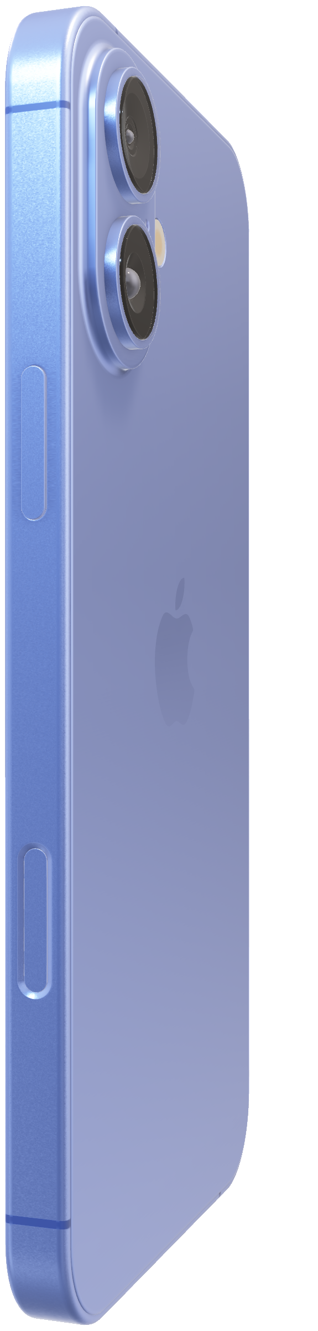
Analog Computer
EN2091 - Laboratory Practice and Projects.

Slide 3
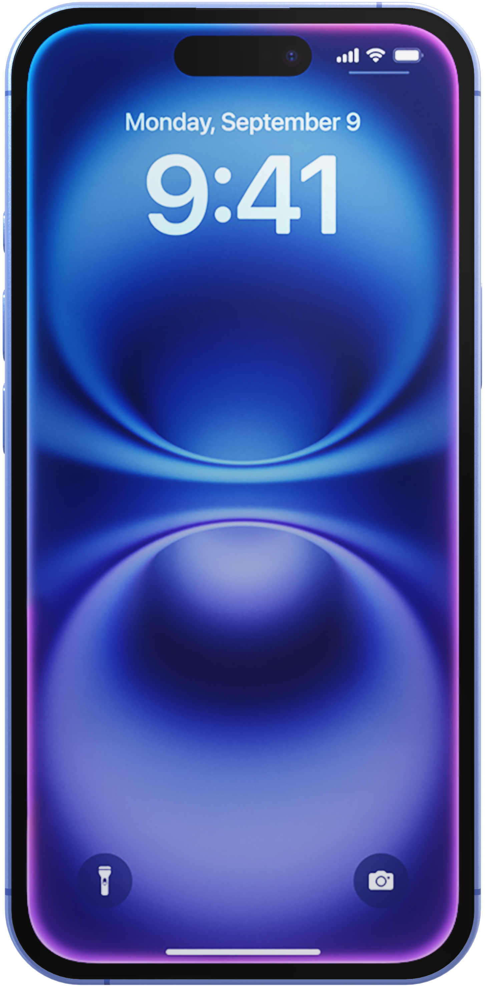
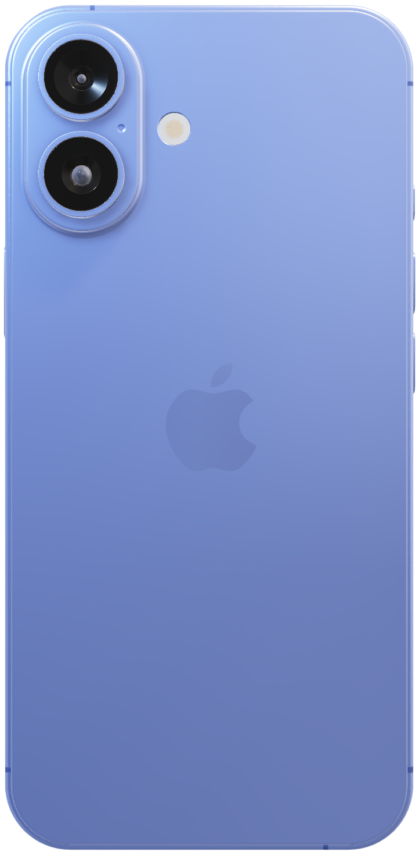
Analog Computer
EN2091 - Laboratory Practice and Projects.
The first iPhone built for Apple Intelligence. Personal, private, powerful.
Analog Computing.
Precision in every operation.
Coming this fall.

Slide 4
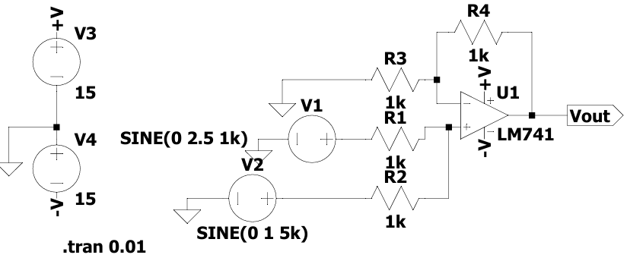
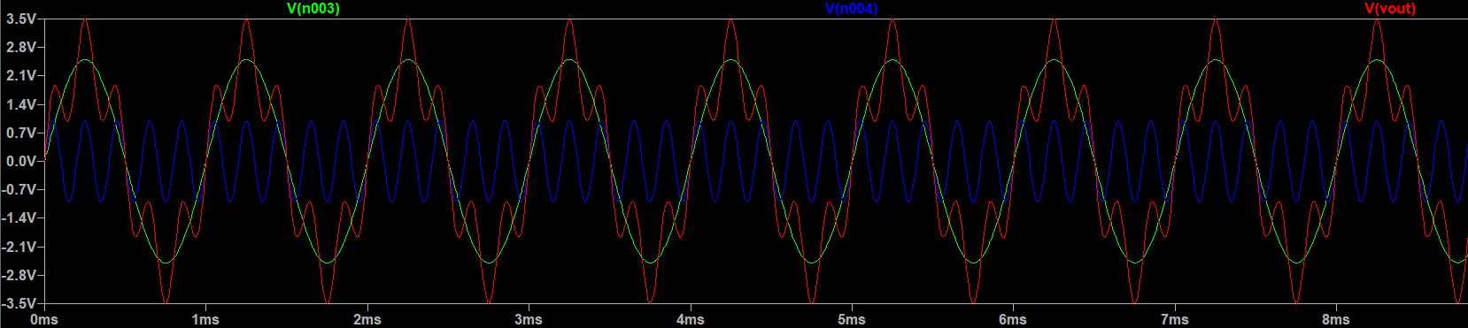
Simulation Results.
Adder Circuit.

Slide 5
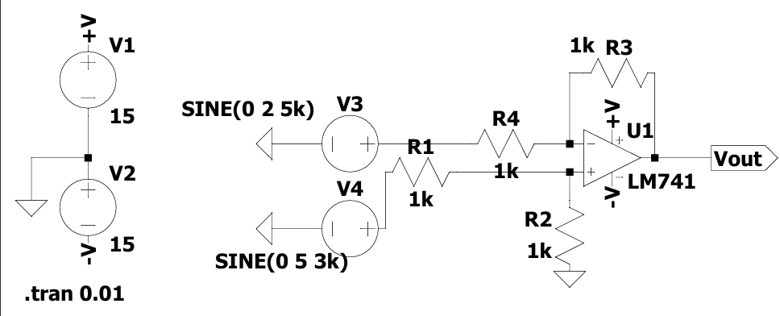
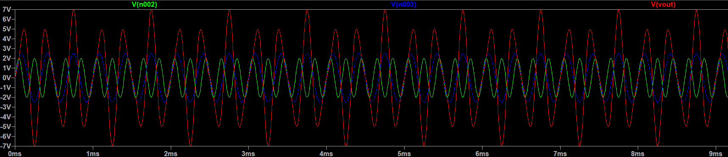
Simulation Results.
Subtractor Circuit.

Slide 6
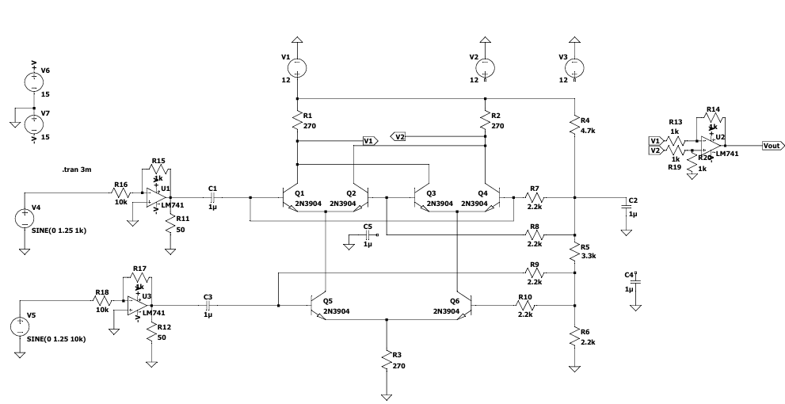
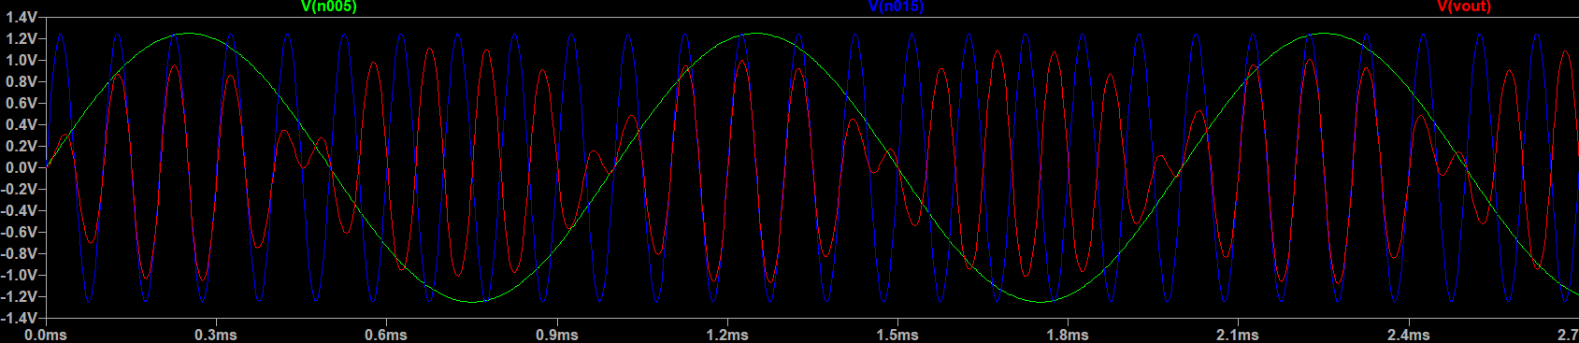
Simulation Results.
Multiplier Circuit.

